Slide 1



BEAUTY BLISS MANAGEMENT
Presented By,
Kannagi G(811722104068)
Kiruthika R(811722104077)
Narmadha N (811722104099)
Guided By,
Ms.S.Uma Mageshwari, M.E.,
DD/MM/YYYY

Slide 2


ABSTRACT
The Beauty Bliss Management is a web-based application designed to streamline the process of scheduling beauty services for customers while enhancing the efficiency of parlour operations. This project aims to eliminate the traditional manual booking methods by offering an online platform where users can view available services and book appointments based on their preferred time slots. Customers can register, log in, explore various beauty packages, and manage their bookings. Admins can manage service listings, staff schedules, and monitor appointments. Developed using HTML, CSS, JavaScript and PHP/MySQL, this system enhances customer satisfaction through convenience, reduces wait times, and improves overall management efficiency in beauty parlours.
DD/MM/YYYY

Slide 3
OBJECTIVE
1. To develop a Beauty Bliss Management using PHP and My SQL
2. To provide a user-friendly interface for customers and admin.
3. To automate appointment booking and Service management.
DD/MM/YYYY

Slide 4
LITERATURE SURVEY
S.No. | Paper Title | Year | Remark
1 | Smart Appointment Scheduling System for Beauty Parlours Using AI | 2023 | Utilizes AI to predict popular time slots and optimize staff allocation to reduce waiting times.
2 | Cloud-Based Beauty Parlour Management System with Online Booking | 2022 | Combines booking, inventory, and employee scheduling into a single cloud platform to streamline operations.
3 | Beauty Salon Appointment System with Real-Time Slot Availability | 2021 | Emphasizes a dynamic slot availability feature, enhancing user convenience and optimizing salon resources.
DD/MM/YYYY

Slide 5
LITERATURE SURVEY
S.No. | Paper Title | Year | Remark
4 | Automated Booking and Management System for Beauty Salons Using Cloud Technology | 2020 | Highlights cloud integration for scalability and centralized management, improving accessibility for both clients and staff.
5 | Mobile Application for Beauty Parlour Appointment Scheduling | 2019 | Focuses on a mobile app to enhance user experience by enabling on-the-go booking and real-time updates on appointment status.
6 | Online Appointment Booking System for Beauty Salons | 2018 | This paper proposes a web-based system that allows customers to book salon services conveniently, reducing waiting time and improving service management
DD/MM/YYYY

Slide 6
LITERATURE SURVEY
S.No. | Paper Title | Year | Remark
7 | Design and Implementation of an Appointment System for Salons with SMS Notification | 2017 | Includes automated SMS reminders to reduce no-shows and improve customer retention.
8 | Development of a User-Friendly Appointment Booking System for Beauty Services | 2016 | Focuses on UI/UX design improvements for ease of use by customers of various age groups.
9 | Mobile Application for Beauty Parlour Appointment Scheduling | 2015 | Focuses on a mobile app to enhance user experience by enabling on-the-go booking and real-time updates on appointment status
DD/MM/YYYY

Slide 7
EXISTING SYSTEM
Operational Inefficiencies: Manual appointment handling leads to overlapping or missed bookings, while billing is time-consuming and prone to errors.
Poor Data and Staff Management: Lack of centralized systems results in lost customer data, untracked client preferences, and inefficient staff scheduling.
Inventory and Resource Issues: No integrated monitoring of product usage or stock levels often leads to shortages, wastage, or overstocking.
DD/MM/YYYY

Slide 8
PROPOSED SYSTEM
We ought to make a beauty services management system.
We aim to make a web-based service application with an appointment scheduling system.
In this application users shall be allowed
a) To review beauty services & make an appointment online.
b) Users shall also be given the option to chat with beauticians & give feedback regarding the services.
c)This system will help solve the problem of finding the best services in the nearby localities.
DD/MM/YYYY

Slide 9
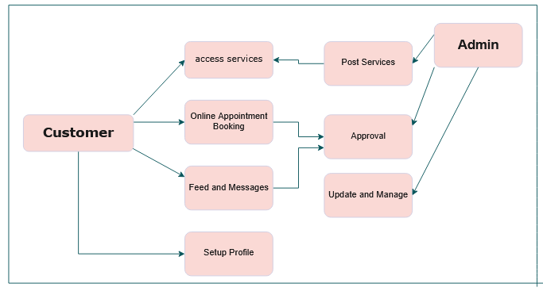
SYSTEM ARCHITECTURE
DD/MM/YYYY

Slide 10
MODULE 1 : Admin
Centralized Dashboard Access: After secure login, admins can view real-time data including daily appointments, total earnings, popular services, inventory status, and employee workloads—enabling quick decision-making.
Service Management: Admins can add, update, or remove services, set pricing and durations, and apply discounts or festive offers to attract customers.
Appointment Handling: Admins manage appointment requests by approving, rescheduling, or assigning them to available staff, ensuring no booking conflicts and smooth workflow.
DD/MM/YYYY

Slide 11
MODULE 1 : Admin
Staff Management: Employee records, work schedules, roles, and assigned services are maintained. Performance tracking is enabled via completed tasks and customer feedback.
Inventory and Billing: The module tracks product usage, sets minimum stock levels for restock alerts, manages supplier details, and automates invoice generation with tax and discount handling.
Reporting and Customer Feedback: Detailed reports on income, service trends, customer growth, and staff performance can be generated. Admins can also respond to customer feedback and enquiries promptly.
DD/MM/YYYY

Slide 12
MODULE 2 :User
User Registration & Login: Customers can register with basic details (name, email, phone, password) and log in to access a personalized dashboard.
Service Browsing: Users can explore categorized services (skincare, haircare, makeup, spa), each with descriptions, prices, durations, and availability for informed decision-making.
Appointment Management: Clients can book, reschedule, or cancel appointments based on staff availability, with updates reflected in the admin panel in real-time.
DD/MM/YYYY

Slide 13
MODULE 2 : User
Booking History & Transactions: A detailed record of past appointments, invoices, and payments is maintained for transparency and easy tracking of service usage and costs.
Profile & Preferences Management: Users can update their profile details, change passwords, and benefit from personalized experiences like saved preferences and service suggestions.
Digital Invoices & Notifications: Customers receive digital invoices for each visit and get promotional alerts or offers, enhancing convenience and engagement.
DD/MM/YYYY

Slide 14
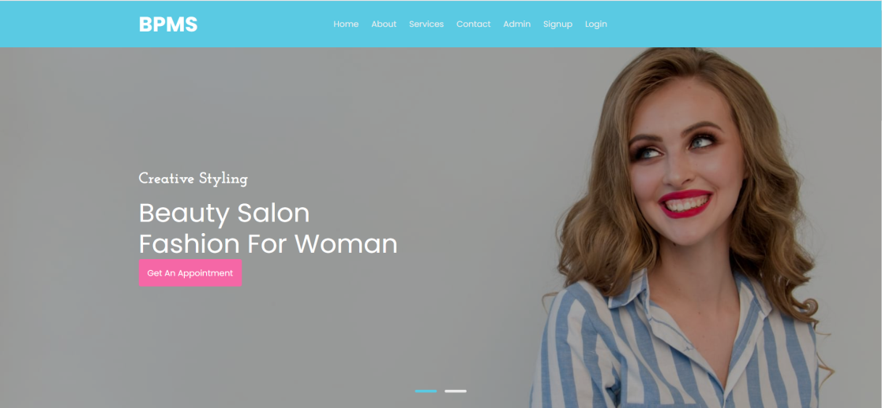
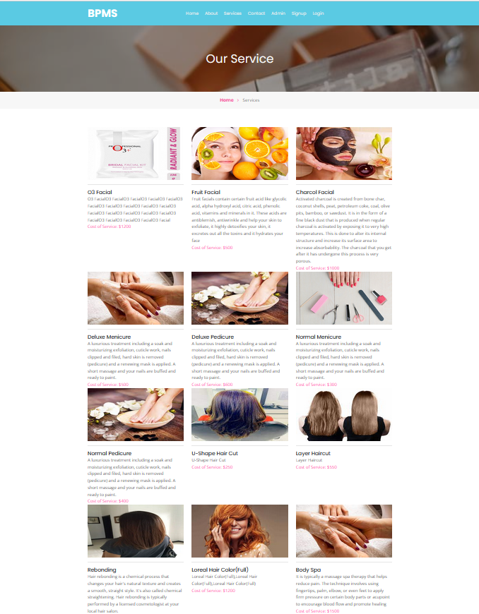
OUTPUT
DD/MM/YYYY

Slide 15
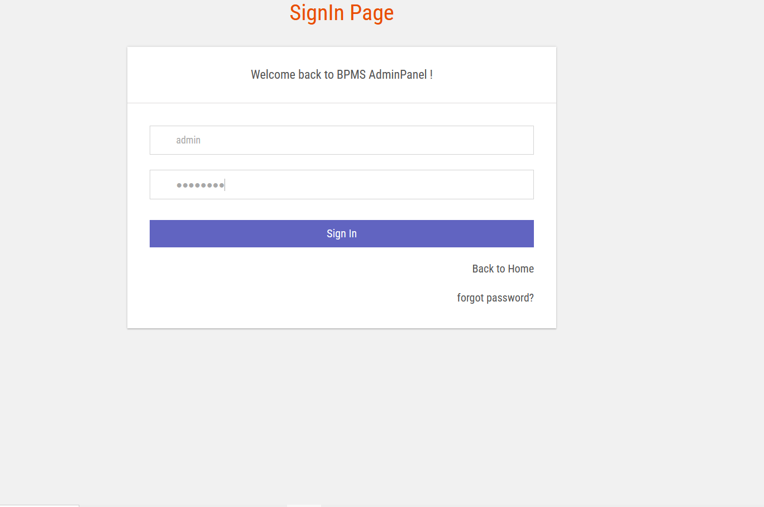
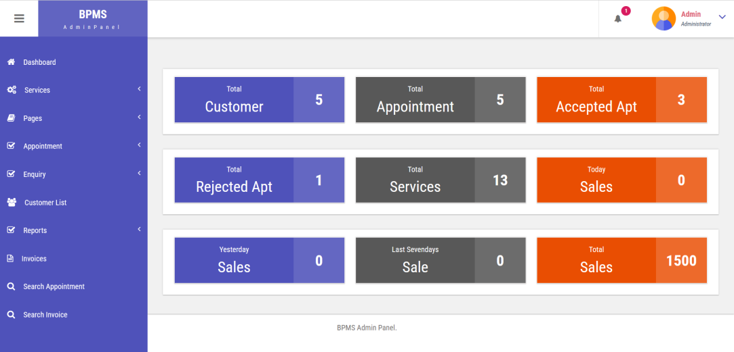
OUTPUT
DD/MM/YYYY

Slide 16
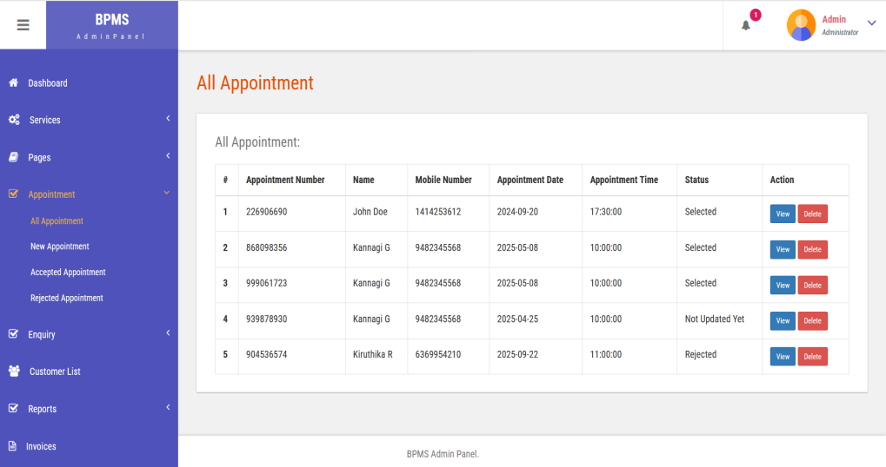
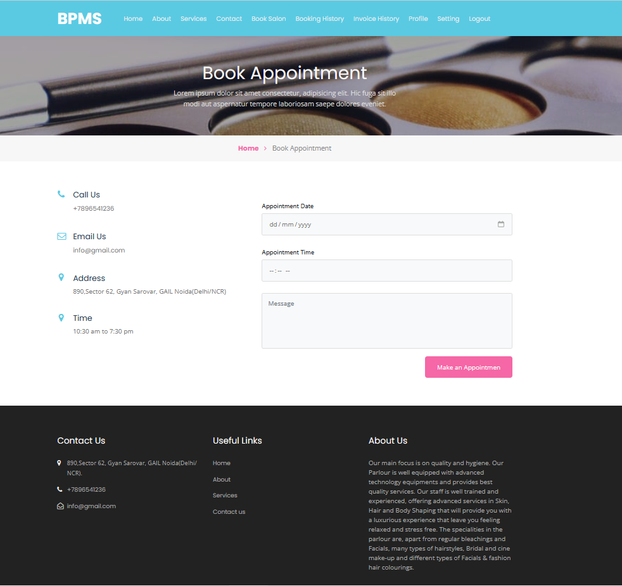
OUTPUT

Slide 17
CONCLUSION & FUTURE ENHANCEMENT
Conclusion:
The project successfully replaced manual salon operations with a reliable, user-friendly web-based system that enhanced administrative efficiency and improved customer satisfaction. It met all design goals and proved to be stable, scalable, and effective in real-world usage.
Future Enhancement: Planned upgrades include a mobile app, voice command support, integration with payment and notification APIs, loyalty programs, advanced analytics, biometric check-ins, and multi-branch support—aimed at boosting accessibility, automation, and long-term growth potential.
DD/MM/YYYY

Slide 18
REFERENCES
1. Kumar, A. (2019). Online Beauty Salon Booking System. International Journal of Computer Applications, 975(8887).
2. Maria, V. N., Dhanush, S., & Ranjitha, R. (2020). Development of Spa and Beauty Salon Management System. International Journal of Advanced Research in Computer Engineering & Technology (IJARCET), 9(5), 2155–2161.
3. Singh, S., & Mehta, A. (2018). Customer Relationship Management in Salons Using Digital Tools. Journal of Business and Technology, 6(3), 144–150.
4. Priya, R., & Ramesh, M. (2021). A Study on Inventory and Appointment Management in Salons. International Journal of Engineering Research & Technology (IJERT), 10(7), 1–4.
5. Sowmiya, R., & Prakash, K. (2020). Design and Development of a Salon Automation System. International Research Journal of Engineering and Technology (IRJET), 7(9), 100–105.
DD/MM/YYYY

Slide 19

DD/MM/YYYY

